Slide 1

WeatherEase
Accessible Weather App for Blind and Visually Impaired Users
Group Members:
Tajra Sinanagic,
Ehab Mohamed,
Mike A. Khadeida.
Supervisor:
Basak Taylan (CUNY Brooklyn College)
Course: CISC 4900
Date: Sept 2025

Slide 2
Organization chart
TAJRA – Team Lead
sinanagict@gmail.com
CODING
Repo setup
API
Speech features
LEAD
Creating Weekly Plans
Coordinating tasks
Reviewing progress
EHAB – Individual Contributor
ehabm7986@gmail.com
CODING
UI structure
Error handling
Command mapping
Testing & Debugging
Mutual collaboration in code with Tajra
MIKE – Individual Contributor
mike.khadeida@gmail.com
RESEARCH
Accessibility guidelines
User testing plans
Reporting findings
Supporting UI/UX improvements
Team
ClearPath
BASAK TAYLAN – Supervisor
basak.taylan@brooklyn.cuny.edu

Slide 3
Easy Breezy Forecasts
(elevator pitch)
WeatherEase is designed for blind and visually impaired users, making weather updates simple, fast, and inclusive.
Our mission is clear: to ensure everyone, rain or shine, can access the forecast with ease.
By replacing visuals with spoken updates and intuitive voice controls, WeatherEase transforms weather checking into an effortless and empowering experience.

Slide 4

Tools & Technologies
LANGUAGES
HTML5
CSS3
JavaScript
API
OpenWeatherMap
Web Speech API
SpeechSynthesis API
PWA COMPONENTS
manifest.json (app metadata & install behavior)
Service Worker (offline caching)
HOSTING
GitHub
GitHub Pages
PROJECT MANAGEMENT
Notion
Google Docs
DEVICE TESTING
Chrome
Microsoft Edge
Safari (iOS)
Android browsers (Google Play devices)

Slide 5
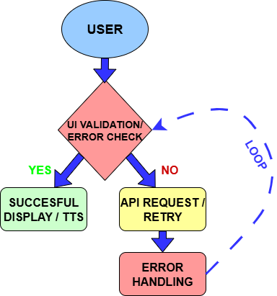
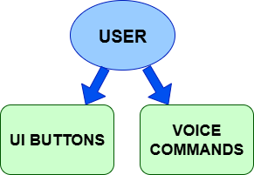
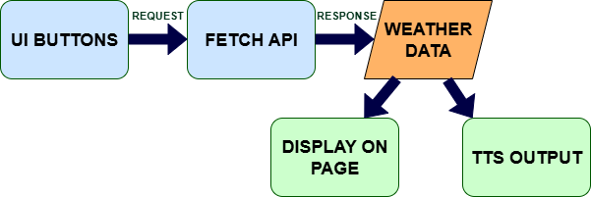
User Interaction Flow
Data Flow Diagram
Error Handling Flow
This diagram shows how the user interacts with the app, either by pressing buttons to get weather or listen, or by issuing voice commands for specific information.
This diagram shows how data flows through the app: the user interacts with UI buttons, which trigger API requests. The API retrieves weather data, which is then displayed on the page and read aloud via text-to-speech
This diagram shows how the app handles errors: input is validated, and if successful, data is displayed and read aloud. If validation fails, the API request handles errors and loops back to re-check the input.

Slide 6
Tentative Schedule – Weeks 3–5 (Approx. 15 hrs/week)
Week | Tajra | Ehab | Mike
3: Sep 8 –14 | repo set up create starter files (index.html, style.css, script.js, manifest.json, service-worker.js) push to GitHub enable Pages basic planning | build HTML layout (<header>, <main>, <footer>) add weather button test keyboard nav minor CSS debug layout | write accessibility guide for blind users share with team review HTML semantic usage
4: Sep 15 – 21 | register OpenWeather API key fetch weather data handle responses debug integration update scripts | display API data on page style temperature/humidity/wind info test keyboard access minor UI fixes | update accessibility checklist with ARIA attributes note progressive enhancement review dynamic content
5: Sep 22 – 28 | implement modular TTS function using SpeechSynthesis API test with sample text debug | connect button to TTS provide visual feedback while reading test keyboard/mouse | suggest concise TTS wording test voice settings guide on reading dynamic info clearly
This schedule shows planned tasks and estimated time per team member for Weeks 3–5, including coding, research, testing, and coordination.

Slide 7

Data Source: OpenWeatherMap API
DATASET NATURE
Provides current weather and forecasts (hourly up to 4 days, daily up to 16 days).
Includes historical data and statistical weather parameters.
Offers weather maps with multiple layers and air pollution data.
Accessible via geocoding API for location-based queries.
Responses are structured in JSON format and updated in real-time.
API usage limits: 3,000 calls/minute, 100 million calls/month for current/forecast data; 50,000 calls/day for historical data.

Slide 8
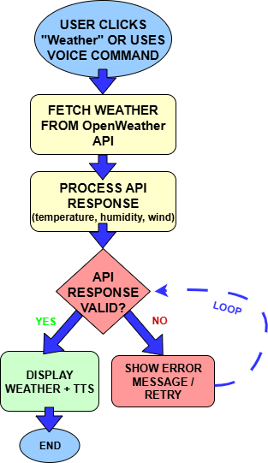
CASE 1: Check Current Weather
In this use case, the user checks the current weather by clicking the 'Get Weather' button or using a voice command.
The app fetches data from the OpenWeatherMap API, processes the temperature, humidity, and wind speed, and displays the results on the screen.
Optionally, the system reads the information aloud using text-to-speech.
If the API response is invalid, an error message is shown, and the system automatically retries the request.

Slide 9
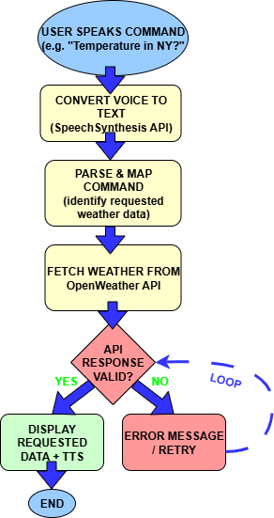
CASE II: Voice Query for Weather Details
In this scenario, the user speaks a command, such as “What’s the temperature in New York?”.
The system first uses the SpeechSynthesis API to convert the spoken input into text, then parses and maps the command to identify the requested weather data.
A call is made to the OpenWeatherMap API, and if the response is valid, the result is displayed on the screen and also read aloud using text-to-speech for convenience.
If the API request fails or the command cannot be understood, the system provides an error message and prompts the user to retry.

Slide 10
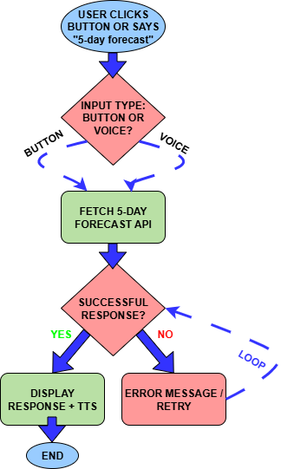
CASE III: Fetching a 5-Day Forecast
In this scenario, the user requests a “5-day weather forecast.”
The system calls the OpenWeatherMap Forecast API and retrieves hourly and daily forecast data for the next five days.
The information is displayed in a clean format on the screen (such as date, temperature, humidity, and conditions).
At the same time, a summary of each day’s weather is read aloud using text-to-speech for accessibility.
If the API call fails, the user is shown an error message with the option to retry.

